Slide 1
SOFT COMPUTING
Title-Uncrewed Sensor Vehicle
Using CNN and BPN

Slide 2
Abstract
This project describes how neural networks can be used to control the steering of an uncrewed sensor vehicle. It is considered that the vehicle is equipped with passive or active sensors providing the range and heading angle information. This project is based on the Convolutional neural networks which receives image frames from the Self Driving Car simulator. Here, in this project, we present a neural network scheme to emulate human driving in order to eliminate the difficulties. Convolutional neural networks are basically deep learning method which primarily works on images. We will be using the vehicle simulator which is specially designed for understanding the concept of such uncrewed sensor vehicles. At the end, it will be shown that the neural network model can be automatically generated with less domain-specific knowledge, can predict steering dynamics more accurately, and perform comparably to a high-fidelity first principles model when used for controlling the steering system of a self-driving vehicle.

Slide 3
Introduction
The networks will be trained by real data obtained from vehicle test runs. At the end, it will be shown that the neural network model can be automatically generated with less domain-specific knowledge, can predict steering dynamics more accurately, and perform comparably to a high fidelity first principles model when used for controlling the steering system of a self-driving vehicle.
Get the pose of the vehicle using the sensors. With pose we get the location of the vehicle relative to the environment.
We look at the environment using depth sense camera or a 3D Lidar and we use ekf localization to fuse the data arriving from sensors- GNSS, IMU, Depth- camera
We create a cost map in the navigation stack and we use move base package

Slide 4
We get two cost maps. One is the global map which gives us a map of overall itinerary and the second is local cost map that is going to help us move the robot or car in the immediate future.
We have two planner in this move base package, one is global planner which communicates directly through the global cost map and the second is local planner which communicates with the local cost map.
We can use a PID- controller, which is proportional integral derivative controller that helps us to stop the rover at a particular position or location as specified because what PID does is that it slows down the robot or car well before it knows that the stopping location is about to arrive.
We use a GPU and we have a GCS, a GCS is a web UI which helps us to control the rover.

Slide 5
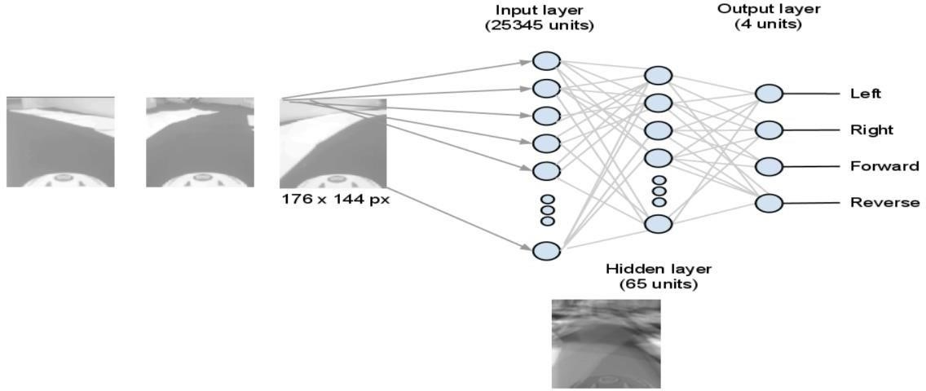
Architecture

Slide 6
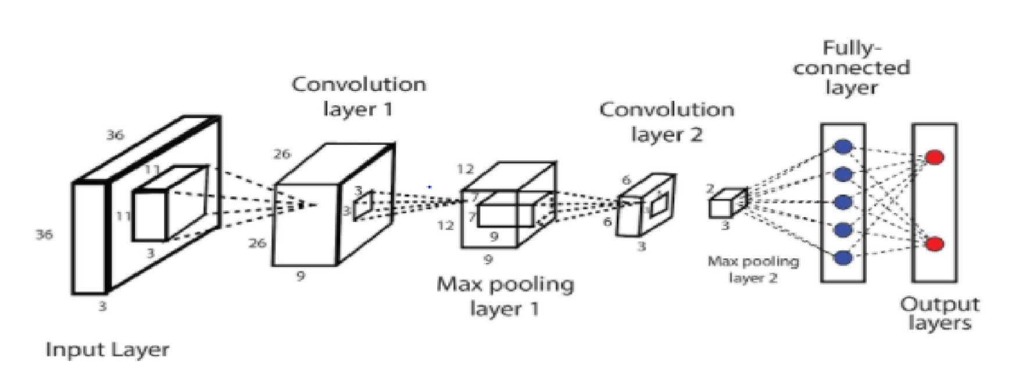
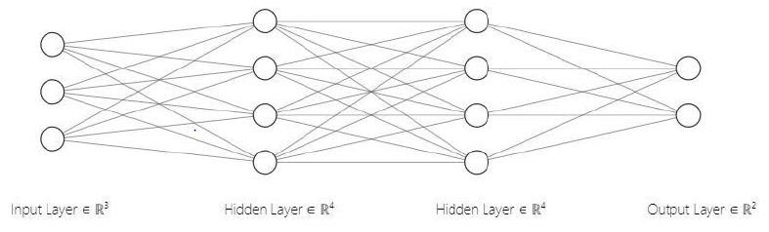

Slide 7
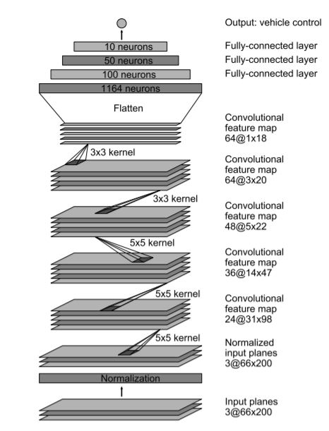

Slide 8
Literature Survey on various Research papers

Slide 9
1)An Autonomous land vehicle in a Neural Network
Abstract: Autonomous navigation has been a difficult problem for traditional vision and robotic techniques, primarily because of the noise and variability associated with real world scenes. Autonomous navigation systems based on traditional image processing and pattern recognition techniques often perform well under certain conditions but have problems with others. Part of the difficulty stems from the fact that the processing performed by these systems remains fixed across various driving situations. ALVINN (Autonomous Land Vehicle in a Neural Network) is a 3-layer back-propagation network designed for the task of road following. Currently ALVINN takes images from a camera and a laser range finder as input and produces as output the direction the vehicle should travel in order to follow the road. Training has been conducted using simulated road images. Successful tests on the Carnegie Mellon autonomous navigation test vehicle indicate that the network can effectively follow real roads under certain field conditions.

Slide 10
2) Statistical localization exploiting convolutional neural network for an autonomous vehicle
Abstract: From this paper, we can get to know that Self localization method will be proposed that exploits object recognition results by using convolutional neural networks (CNNs) for all the autonomous vehicles. Monte-Carlo localization (MCL) is one of the most popular localization methods that use odometry and distance sensor data for determining vehicle position. A global positional error means that particles representing a vehicle's position are distributed in the form of a multimodal distribution, i.e., the distribution has several peaks. Just, to overcome this problem, we propose a method in which an autonomous vehicle employs object recognition results, obtained using CNNs, as the measurement data with a Bag-of-Features representation in an integrative manner. The experimental results show that the proposed method can converge the distribution of the vehicle positions and particle orientations and reduce the global positional errors.

Slide 11
3) Speeding up Back-Propagation Neural Networks
Abstract: There are many successful applications of Back propagation (BP) for training multilayer neural networks. However, it has many shortcomings. Learning often takes long time to converge, and it may fall into local minima. One of the possible remedies to escape from local minima is by using a very small learning rate, which slows down the learning process. The proposed algorithm presented in this study used for training depends on a multilayer neural network with a very small learning rate, especially when using a large training set size. It can be applied in a generic manner for any network size that uses a back propagation algorithm through an optical time (seen time). The paper describes the proposed algorithm, and how it can improve the performance of back propagation (BP). The feasibility of proposed algorithm is shown throughout number of experiments on different network architectures.

Slide 12
4) Combination of Fuzzy Logic Control and Back Propagation Neural Networks for the Autonomous Driving Control of Car-Like Mobile Robot Systems
Abstract: This paper designs a sensor-based behavior fusion mechanism for car-like mobile robot to implement the autonomous driving mission. First, a design of collision prevention system is introduced for the car-like mobile robot. Secondly, the wall-following controller composed of a back propagation neural network and a fuzzy logic control is proposed to make the CLMR move smoothly in the unknown and changing environment. Moreover, the controller design for auto-parking issue which is not only considered the normal parking condition, but taken the complex parking condition into account, is also revealed in this manuscript. Computer simulation results illustrate the effectiveness of the proposed sensor-based behavior fusion mechanism. Finally, the real-time experiments of the autonomous driving control on the test ground demonstrate the feasibility of CLMR maneuvers.

Slide 13
Methodology

Slide 14
Data Generation
Records images from center, left, and right cameras with respect to associated steering angle, speed, throttle and brake.
Saves to CSV
Ideally we need a joystick , but keyboard works too.
Training data generates over 7000 images.
The steering angle corresponds to radian value range from -1 to +1. When steering angle is straight value is 0, left is -1and right is +1.

Slide 15
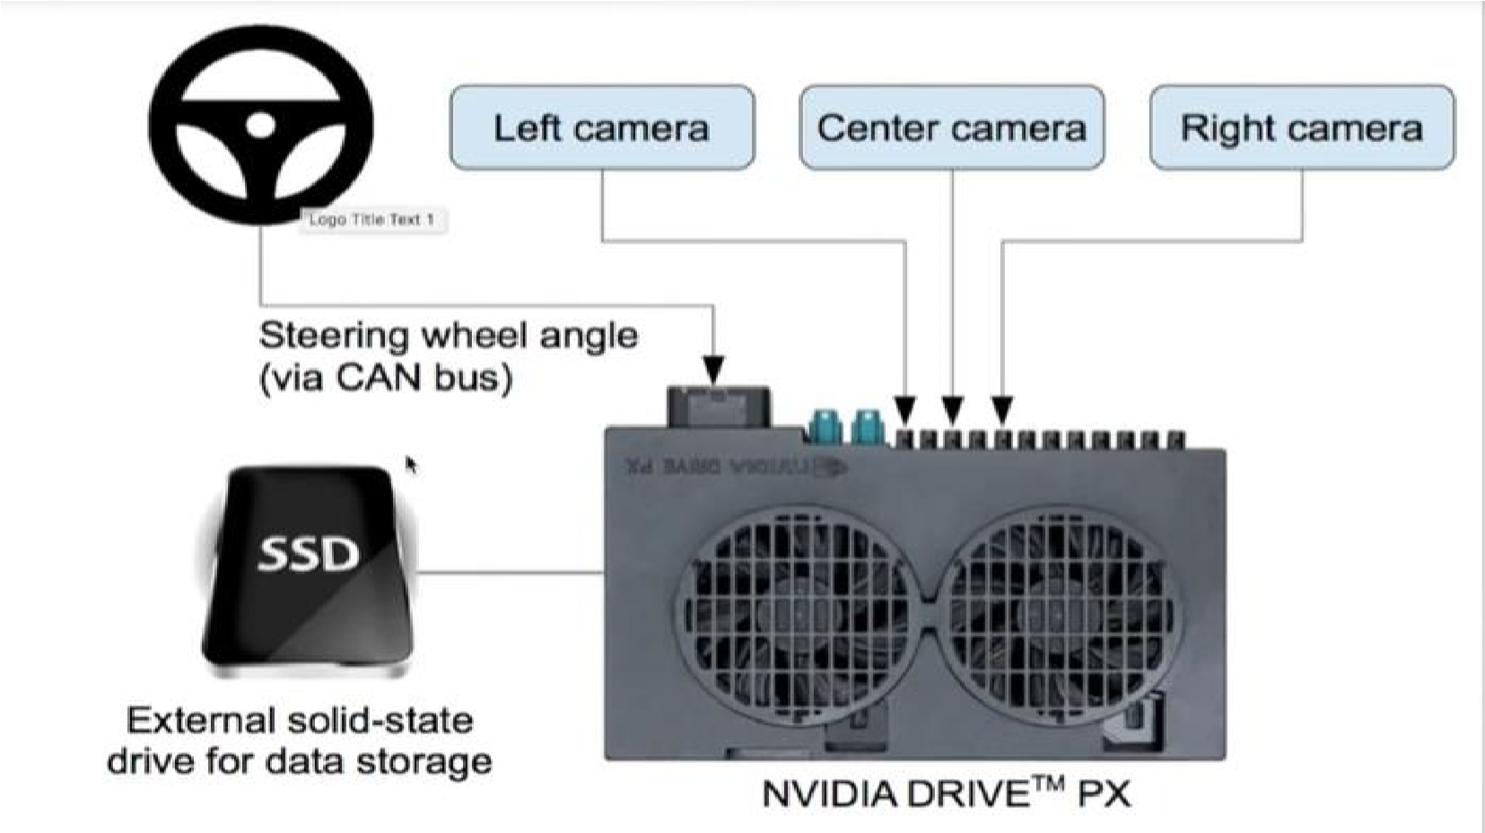
Training mode
Hardware design

Slide 16
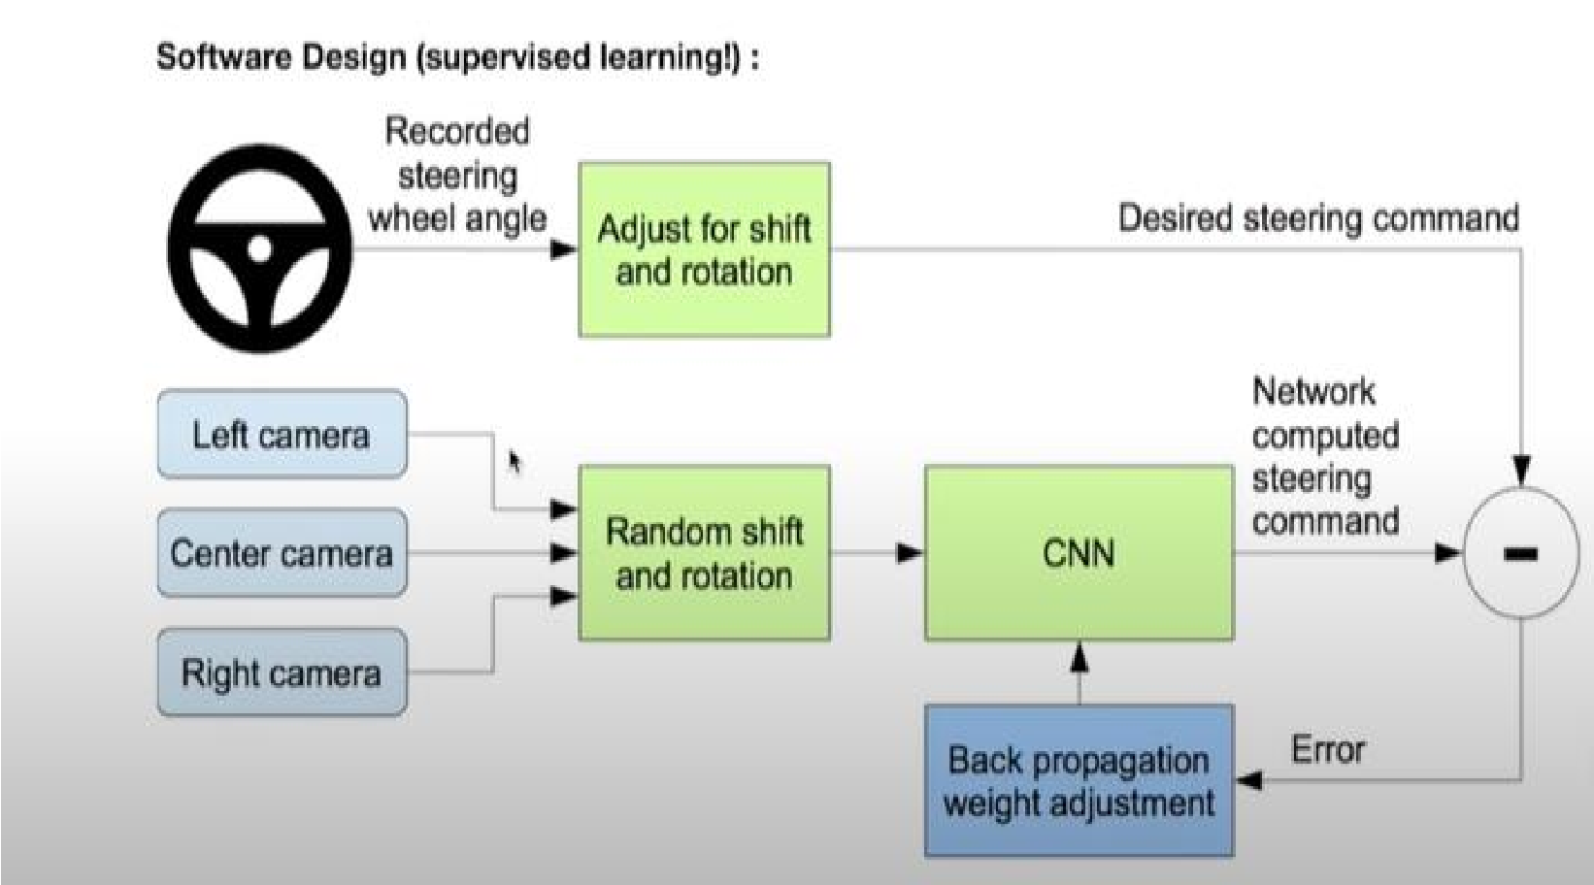
Training mode
Software design

Slide 17
Training mode
Main Building Blocks
Convolutional Neural Networks
Ultrasonic sensors
Steering angle
Brake
Throttle
Speed

Slide 18
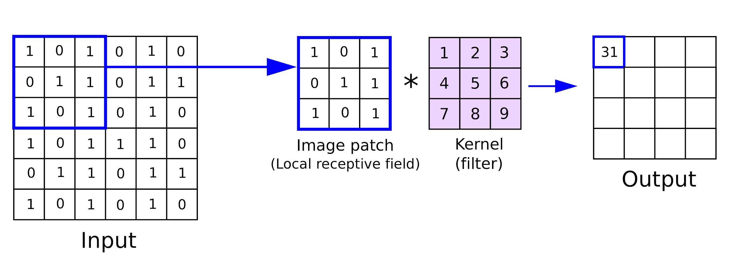
Convolution Layers

Slide 19
Convolution Layers
1 | -1 | -1 | -1 | 1
-1 | 1 | -1 | 1 | -1
-1 | -1 | 1 | -1 | -1
-1 | 1 | -1 | 1 | -1
1 | -1 | -1 | -1 | 1
1 | -1 | 1
-1 | 1 | -1
1 | -1 | 1
7 | 1 | 7
1 | 7 | 1
7 | 1 | 7
Diagonal Feature Kernel
The diagonal feature from the input image matrix is extracted
Image matrix

Slide 20
Activation function
If we compare end-to-end CNN based model is verified using different activation functions, which are
Elu
ReLU
Sigmoid
Elu(Exponential Linear Unit) is the best among the three activation functions. ReLU is constant for the negative values but Elu gradually attains its final value of negative alpha. It is easy to find the derivative of the Elu function. The derivative is required for backpropagation and hence having a function with low computational and memory requirements make the calculations fast to compute.

Slide 21
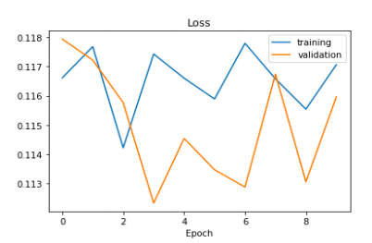
ReLU( Rectified Linear Unit)

Slide 22
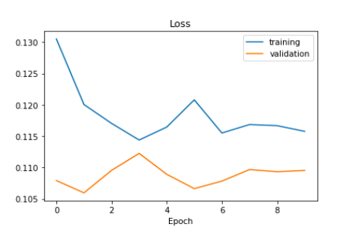
Sigmoid Activation Function

Slide 23
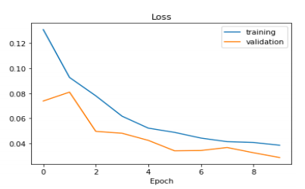
Elu( Exponential Linear Unit)

Slide 24
Results and Discussion

Slide 25
Results and Discussion
While implementing our project, we saw that autonomous cars depend on various technologies like sensors , machine learning networks, complex algorithms, and efficient processing units to execute on software. Based on the readings and outputs of the sensors located in different parts of the vehicle, autonomous cars create and maintain an environment map. Radar sensors monitor the location of vehicles nearby. Video cameras detect traffic lights, read them, track other vehicles and look out for pedestrians.Lidar sensors fire rapid pulses of laser light on the various objects around the car and then measure the distance of the objects, edges of the road and look for the lane markings . When parking, ultrasonic sensors present in the wheels sense the curbs and other surrounding automobiles. Then sophisticated software processes all of this sensory input, plots a path, and sends instructions to the car's actuators to control acceleration, braking and steer. Hardcoded rules, algorithms to avoid obstacles, predictive modelling and object recognition help the software follow traffic rules and navigate barriers.

Slide 26
There are certain challenges and limitations with the autonomous cars. Some of them are:
Weather conditions - Heavy precipitation, thick layers of snow etc pose a serious challenge to the driving of autonomous cars.
Lidar and radar- Lidar is expensive and often tries to strike the right balance between range and resolution. If many autonomous cars drive on the same road, their lidar signals have great chances of interfering with one another. Thus , this issue needs to be taken care of.
Artificial vs Emotional Intelligence- Human drivers rely on subtle signals and non-verbal communication — such as making eye contact with pedestrians or reading other drivers' facial expressions and body language — to call for split second judgment and predict behaviours. It seems unfeasible for autonomous cars to replicate such a connection and have human-like lifesaving instincts.
Traffic Conditions and Laws- It would be difficult for these cars to drive in tunnels or on bridges and also in heavy traffic.

Slide 27
Liability of injuries- Who should be considered responsible for autonomous vehicle accidents? The Fabricator? The passenger? The new blueprints indicate that there would be no dashboard or steering wheel for a completely autonomous Level 5 car, and a human passenger will not even have the option to take control of the vehicle in an emergency situation.
The future benefits of such a technology are limitless. Autonomous cars would benefit the elderly and the disabled and help them become independent. They would also surely improve the quality of living. However, in the future these cars are expected to tackle the following issues as well:
Reduce transportation costs by about 40%
Decrease traffic congestion
Free up parking space for other uses like hospitals, parks etc.
Reduce carbon dioxide emissions by 80% all over the world
Improve livability and walkability

Slide 28
Conclusion
Throughout our research, we have demonstrated that CNNs are able to learn the entire task of following the lane and the road without manual decomposition into detection of road or lane marking, semantic abstraction, route planning and control. The CNN network has demonstrated the ability and potential to drive on roads with various edges of road. From a very sparse training signal CNN is able to learn useful track features. For example, the machine learns to detect the outline of a path without the need of explicit labels during training.
Autonomous cars have been an interesting area of research over the past few years. In the future they are thought to substantially reduce the transportation costs. The path continues to be problematic and faces several challenges.

Slide 29
Environmental awareness remains the greatest obstacle to safe, efficient and smooth driving. There is a long list of research questions spanning a wide spectrum to be discussed and answered, including but not limited to consumer acceptance, social impacts etc. Such cars are expected to become an integral part of modern transport systems in the near future. In addition, given such rapid changes in intelligent transport systems, the education system must align itself with these emerging technologies without question.

Slide 30
Simulation Screenshots

Slide 31
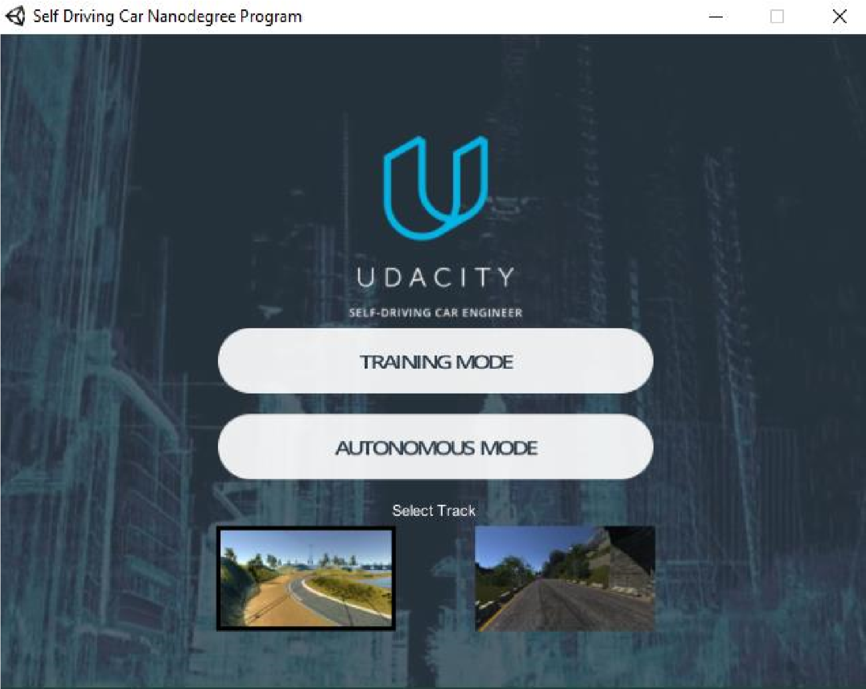
Training Driving

Slide 32
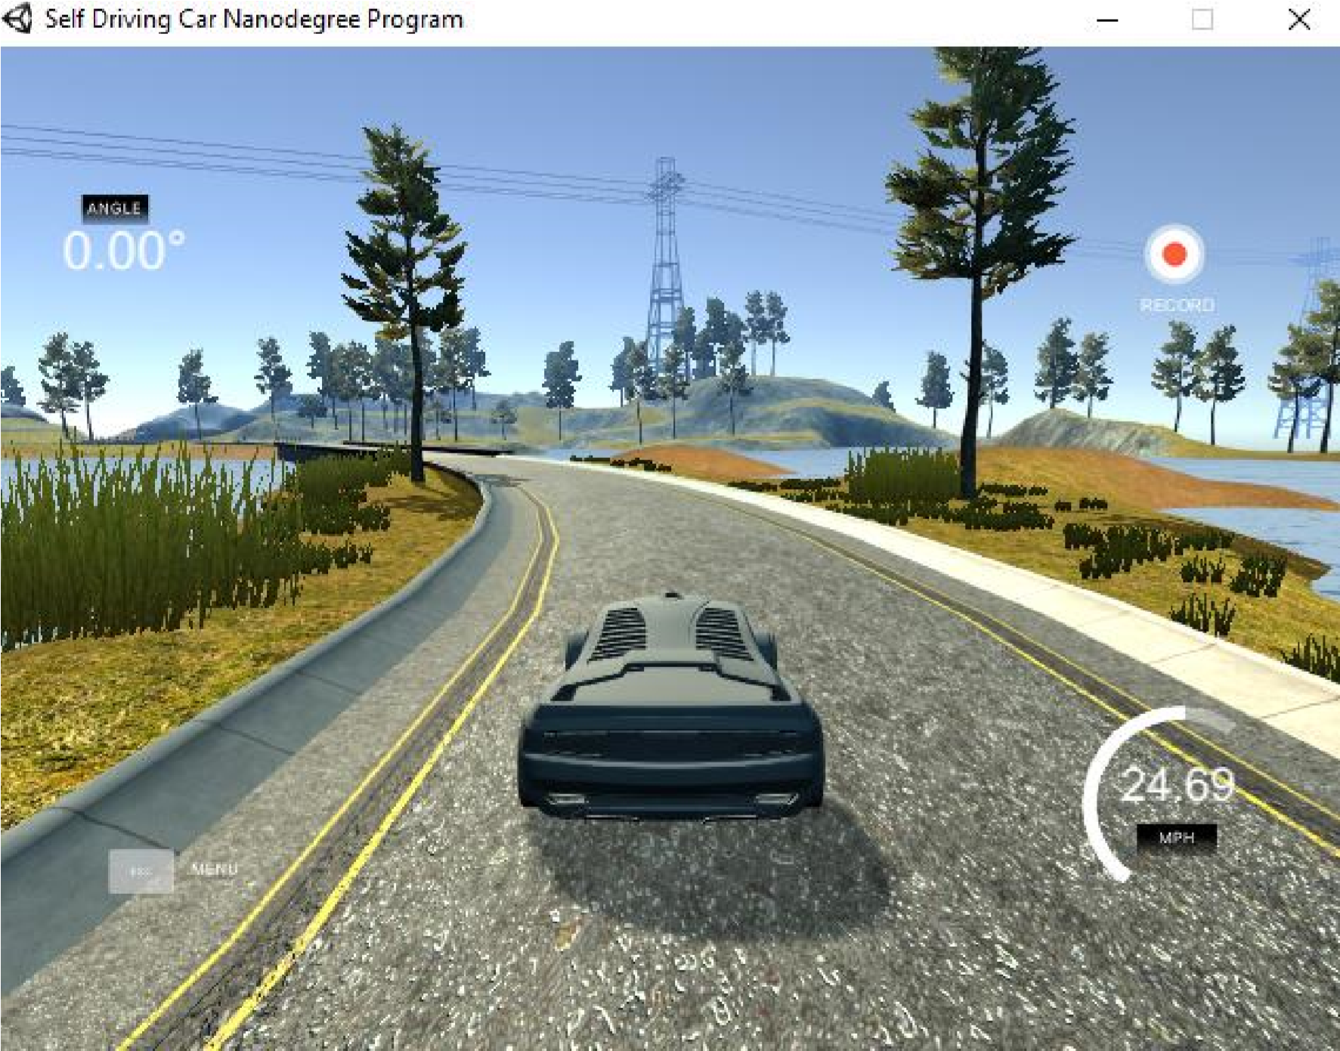

Slide 33
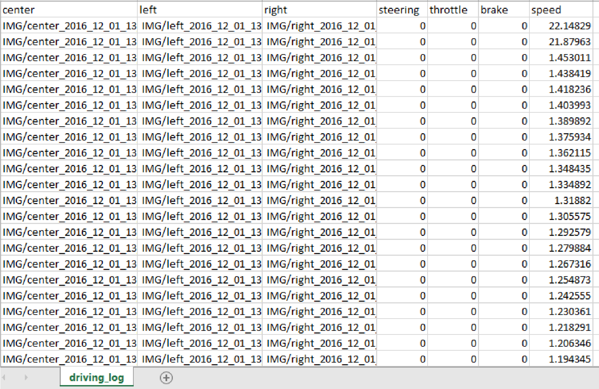

Slide 34
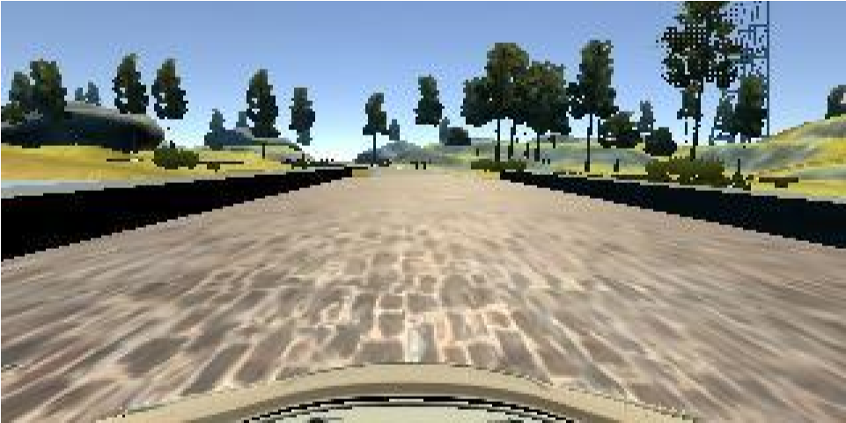
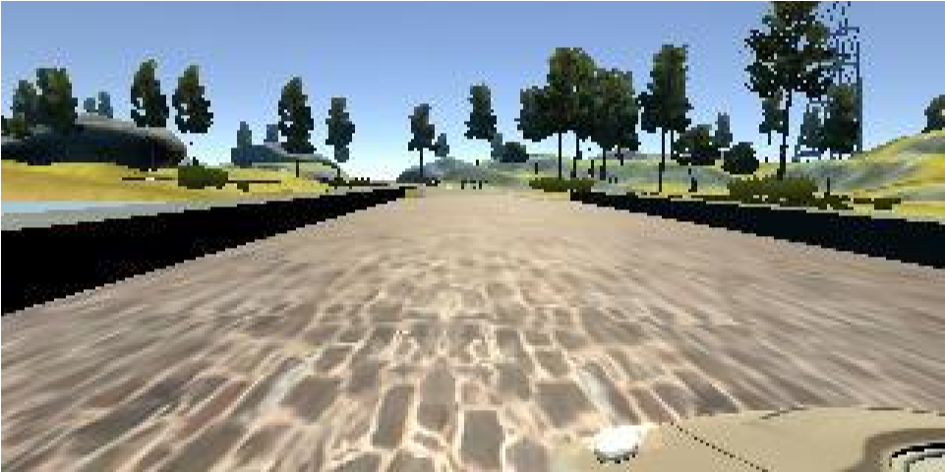

Center
Left
Right

Slide 35
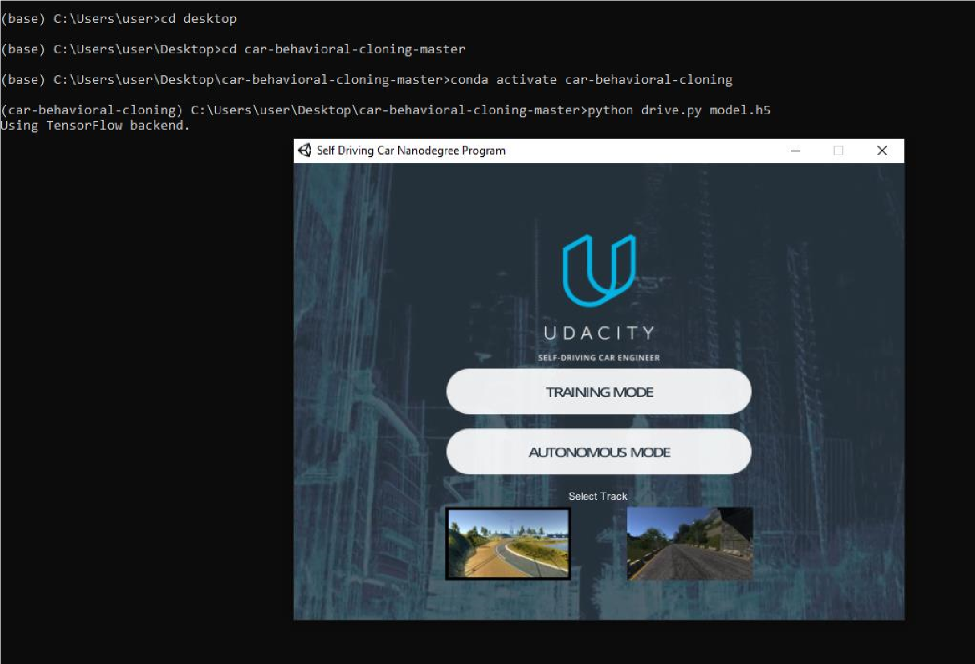
Autonomous

Slide 36
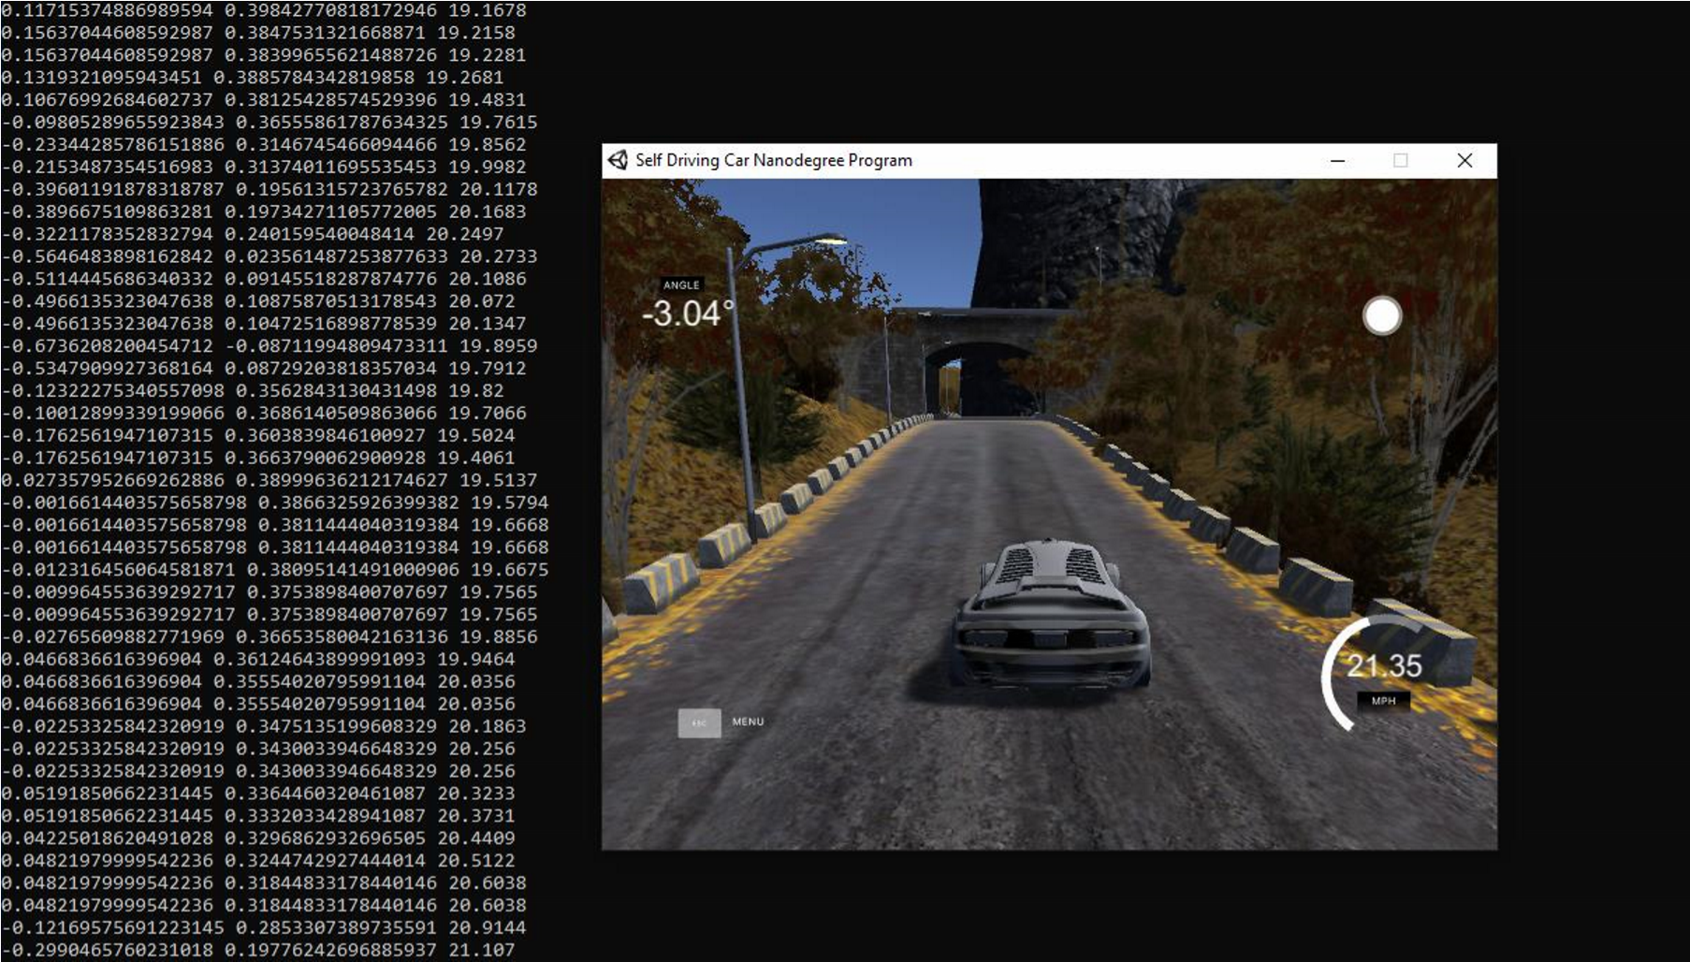

Slide 37
